Slide 1
CIS Check of Bad Laser Channels
Katie Hughes and Dawit Belayneh

Slide 2
Summary
Most of the 33 channels that were bad in laser are also problematic in CIS
Link to Henric’s presentation: https://indico.cern.ch/event/987399/contributions/4604241/attachments/2340236/3989676/HW20211108-laser.pdf
CIS scans are plotted from January 1 2021 - today

Slide 3
Major Problems
EBA_m42_c30_highgain
EBA_m64_c03_highgain
EBC_m18_c04_lowgain
EBC_m23_c03_highgain
EBC_m56_c41_lowgain
LBA_m45_c06_highgain
LBA_m64_c29_highgain
LBC_m01_c25_highgain
LBC_m08_c03_lowgain
LBC_m10_c37_highgain
LBC_m19_c22_lowgain
LBC_m23_c20_lowgain
LBC_m46_c04_highgain
LBC_m47_c35_lowgain
LBC_m59_c26_highgain
General Description:
High Scatter
Far from DB average (81 for HG, 1.29 for LG)
Sudden jumps/steps in CIS value

Slide 4
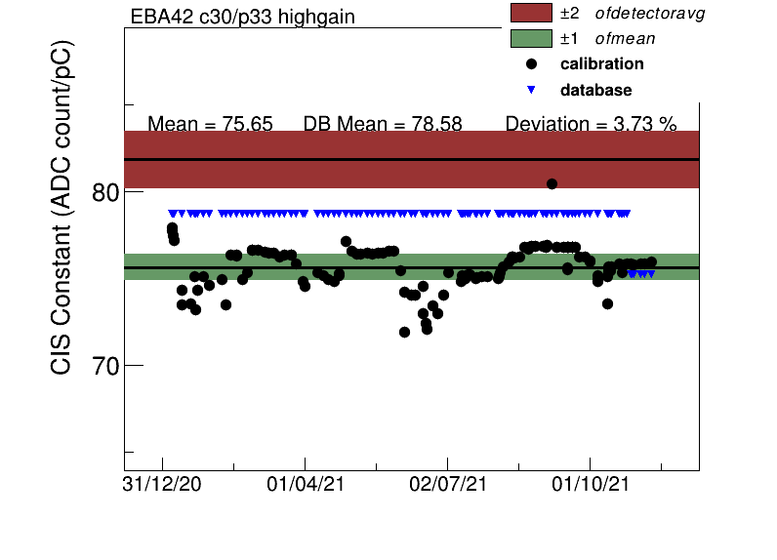
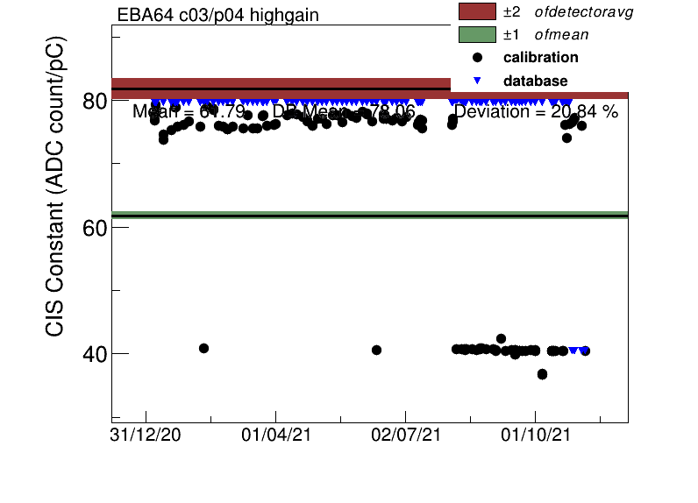
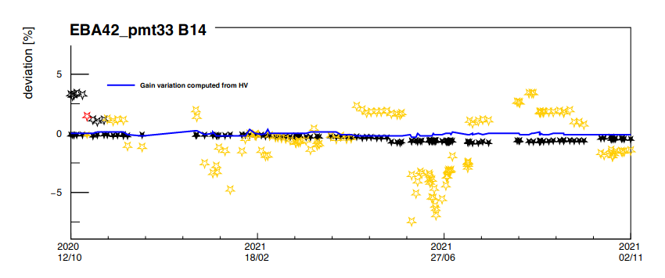
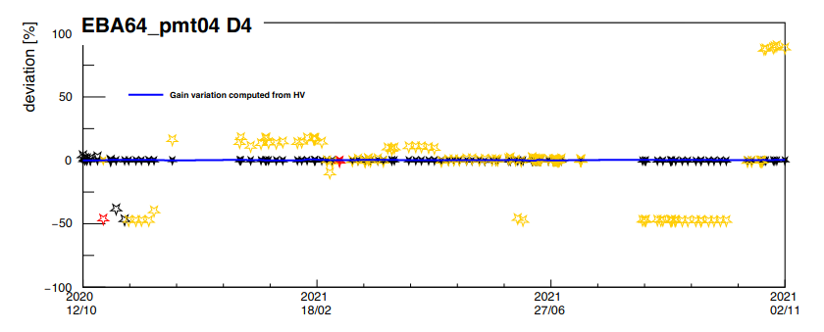

Slide 5
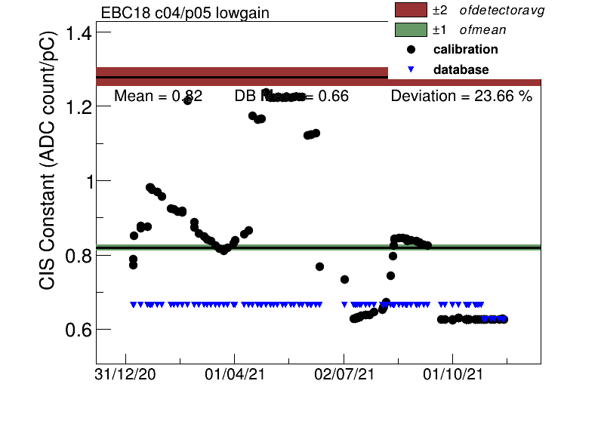
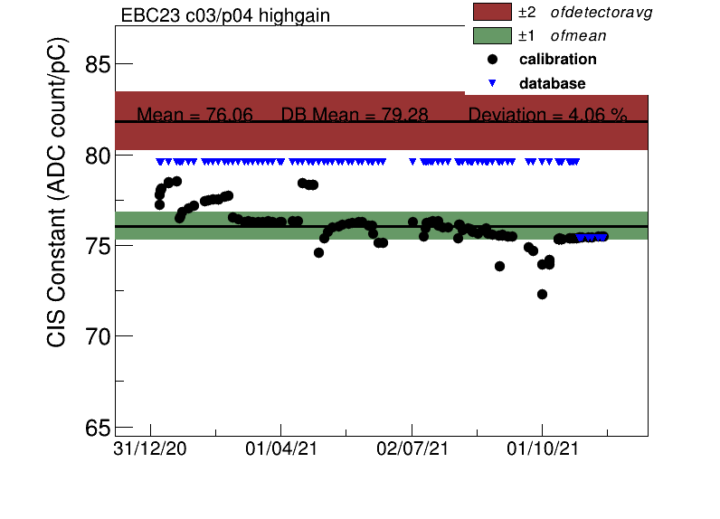
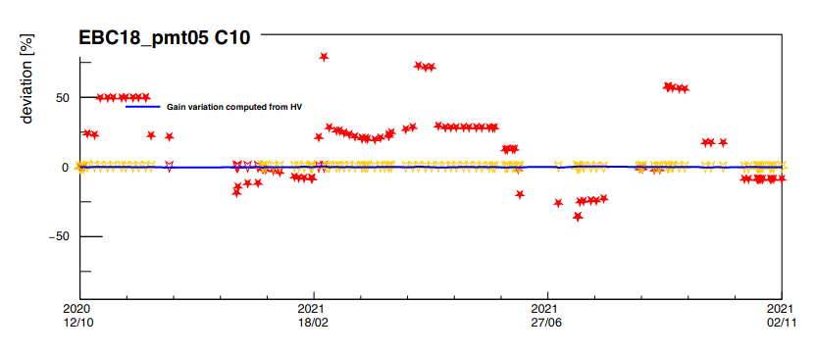
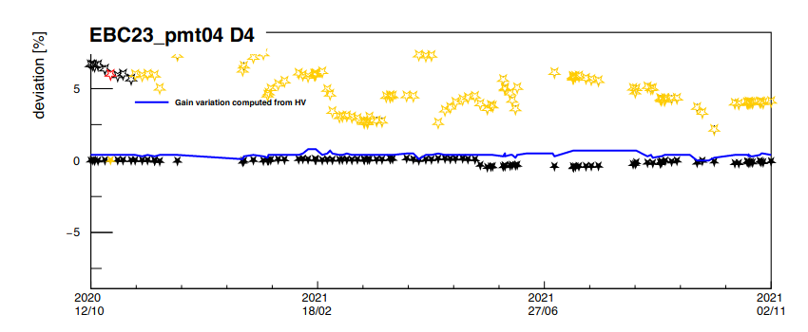

Slide 6
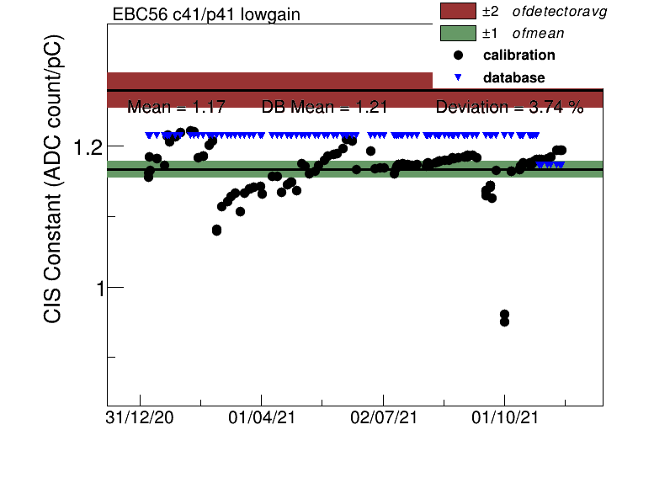
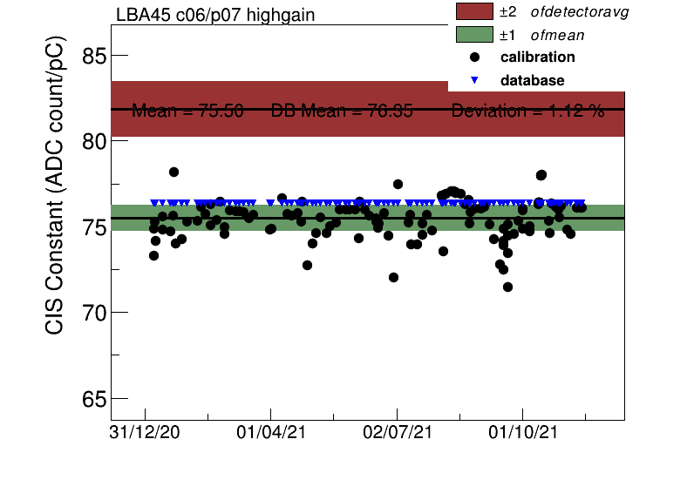

Slide 7
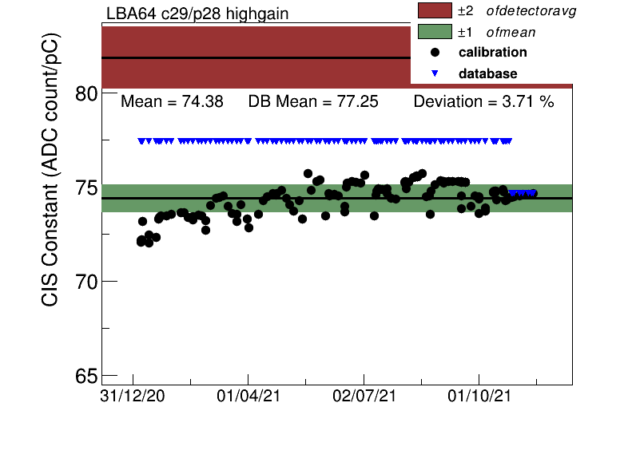
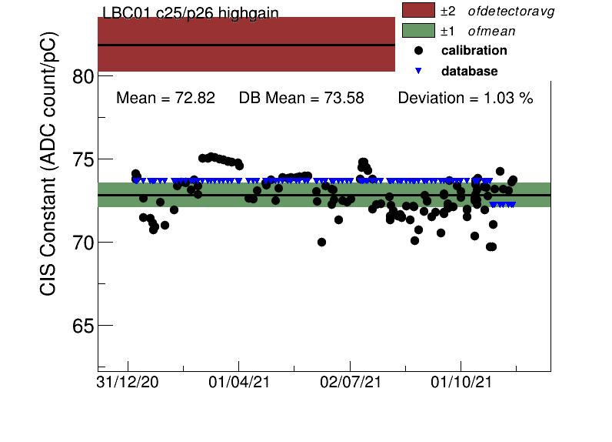

Slide 8
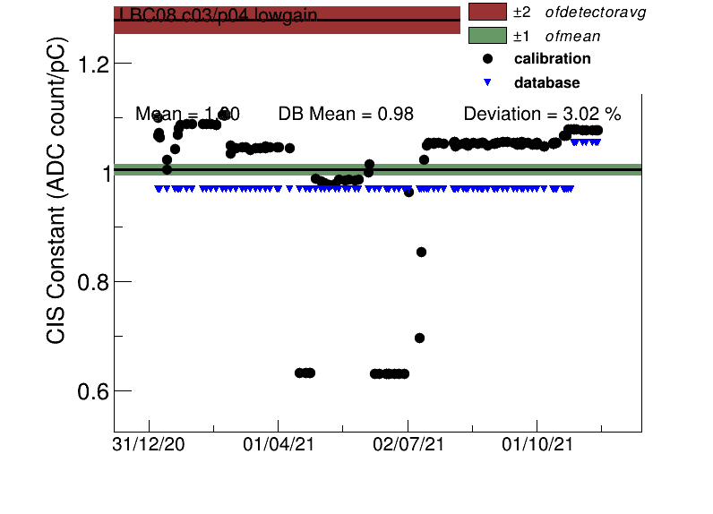
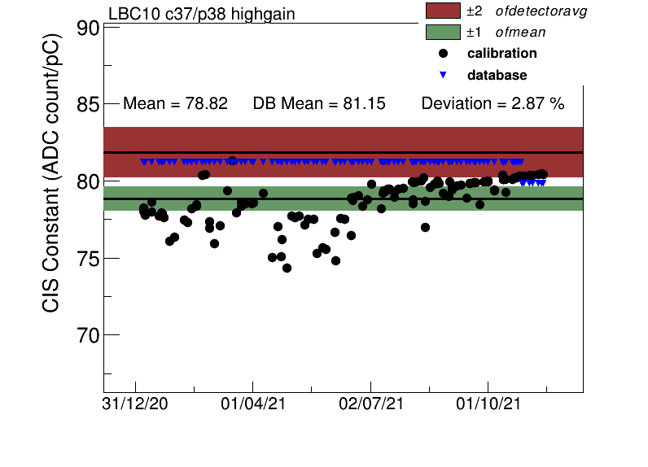

Slide 9
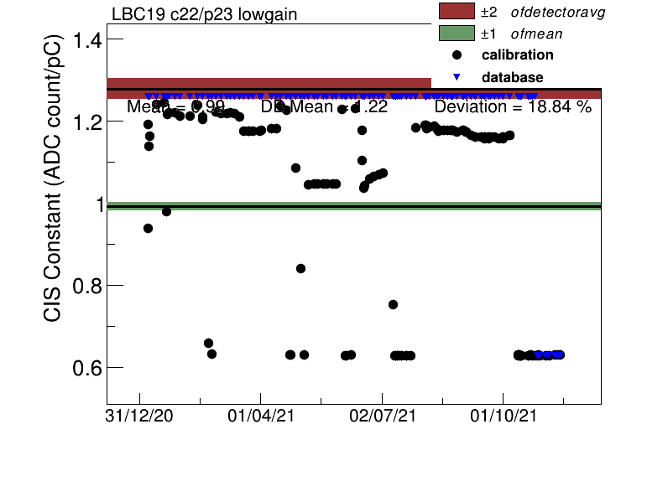
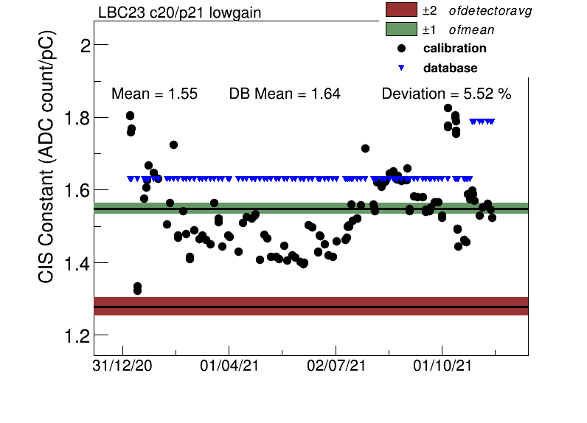

Slide 10
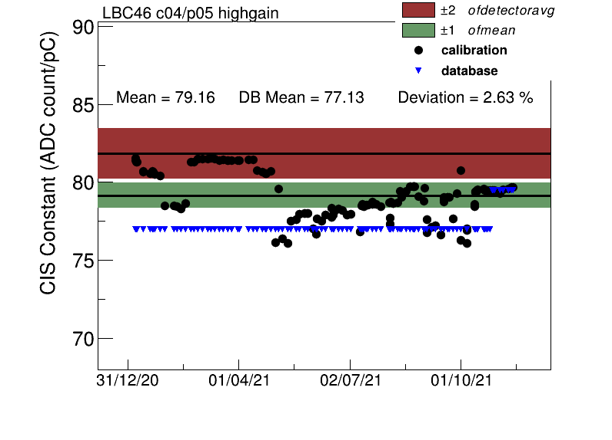
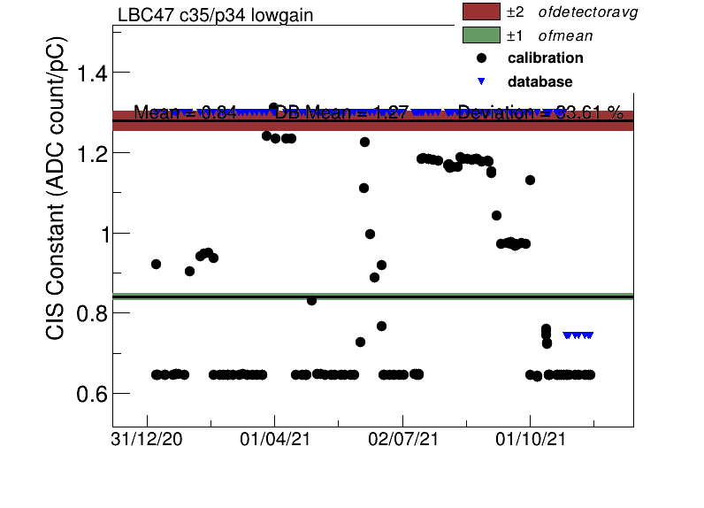

Slide 11
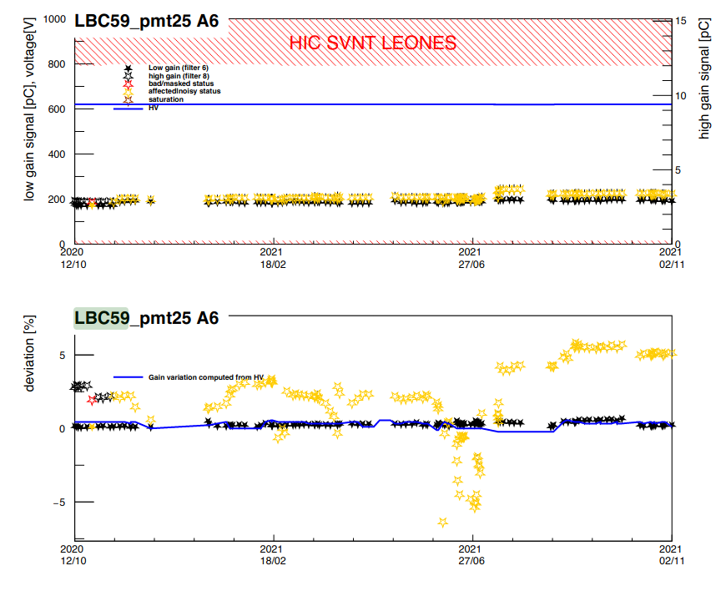
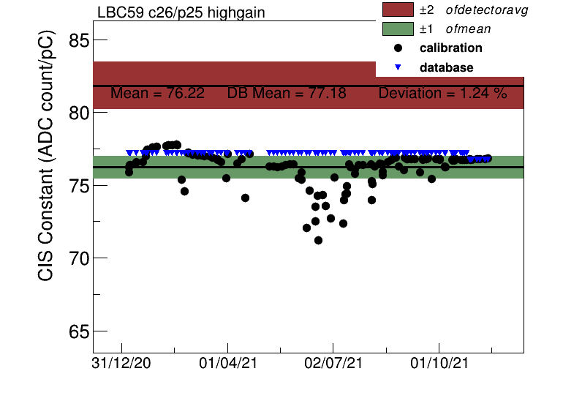

Slide 12
Moderate Problems
EBA_m16_c17_highgain
EBA_m50_c20_highgain
EBA_m55_c22_highgain
EBC_m01_c21_highgain
EBC_m13_c03_lowgain
EBC_m22_c16_lowgain
LBA_m52_c01_lowgain
LBC_m44_c12_highgain
General Description:
Some scatter but close to DB average
Might have stabilized over time
Some small jumps in CIS value

Slide 13
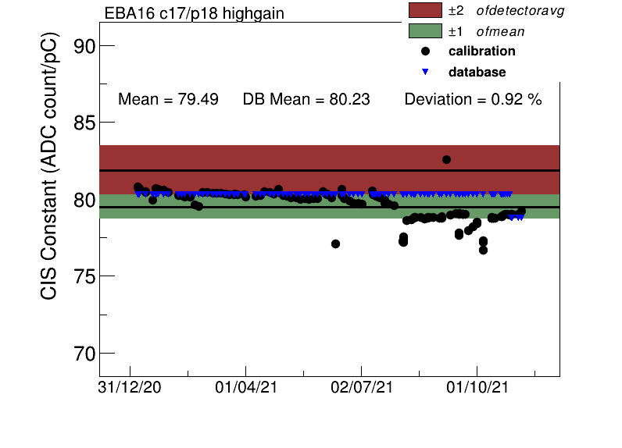
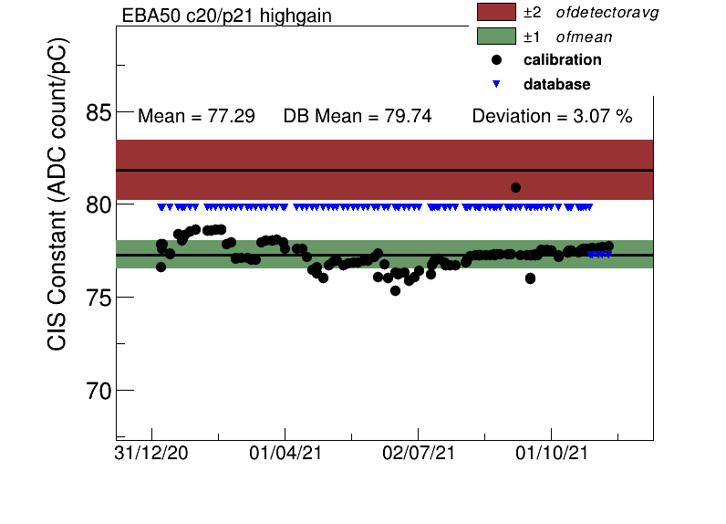
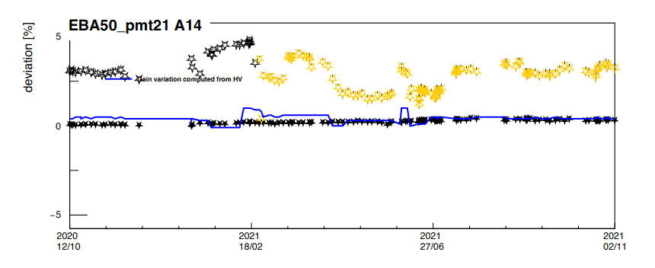
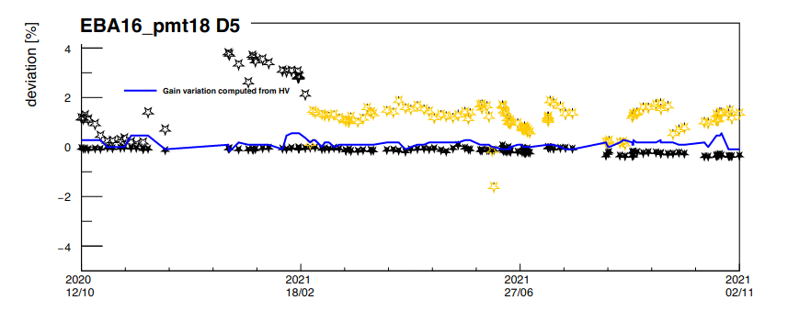

Slide 14
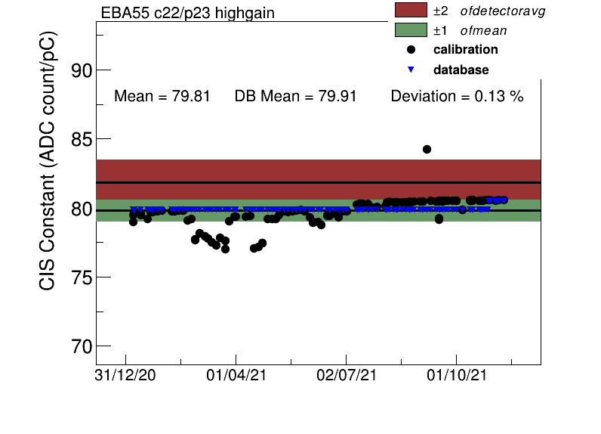
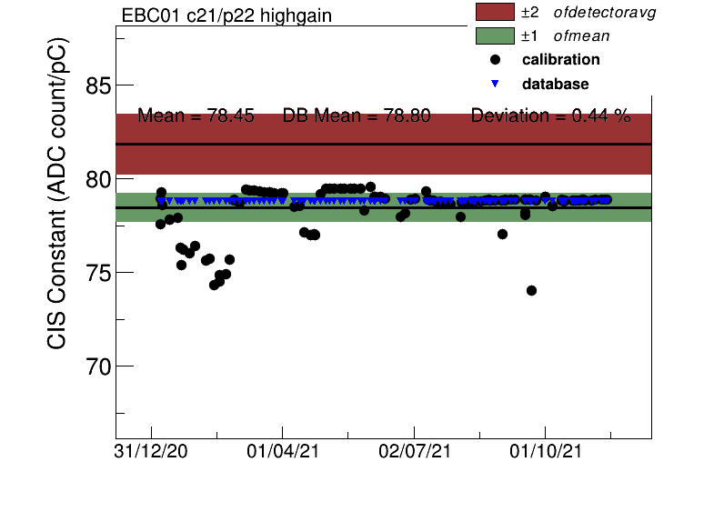

Slide 15
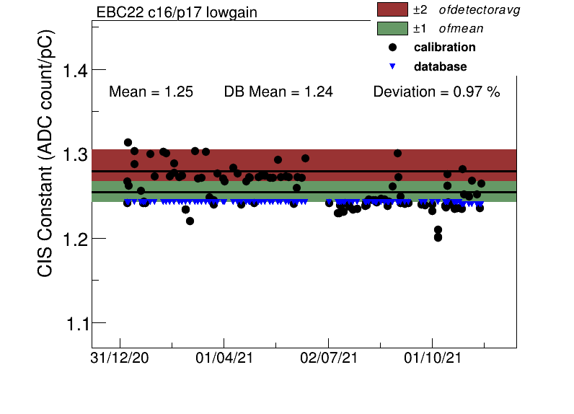
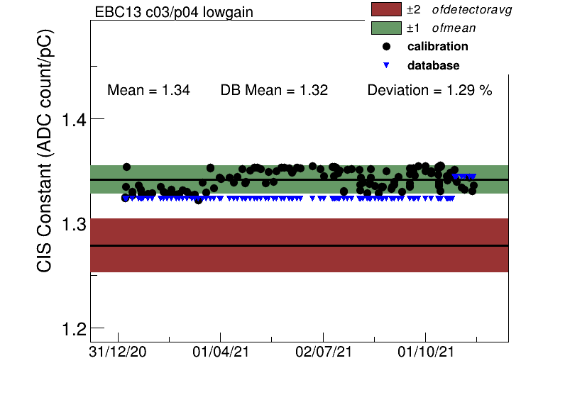

Slide 16
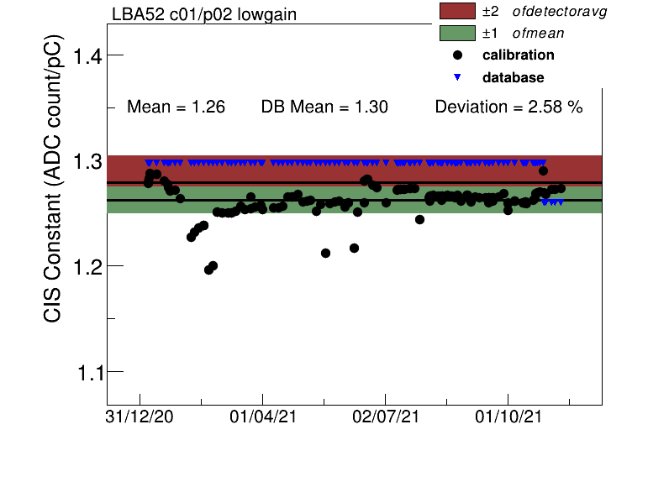
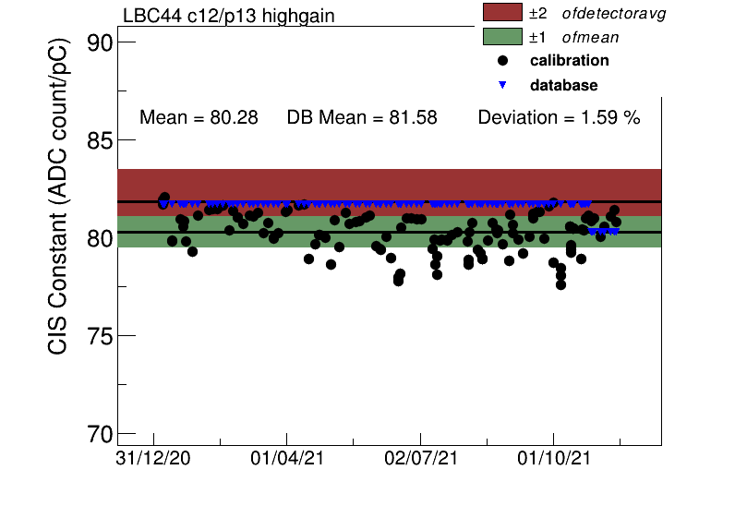

Slide 17
Minor/No Problems
EBA_m19_c41_highgain
EBC_m15_c16_highgain
EBC_m37_c11_highgain
LBA_m21_c47_highgain
LBA_m62_c08_highgain
LBC_m43_c26_highgain
General Description:
Very stable over time
Might have a small handful of outlier points

Slide 18
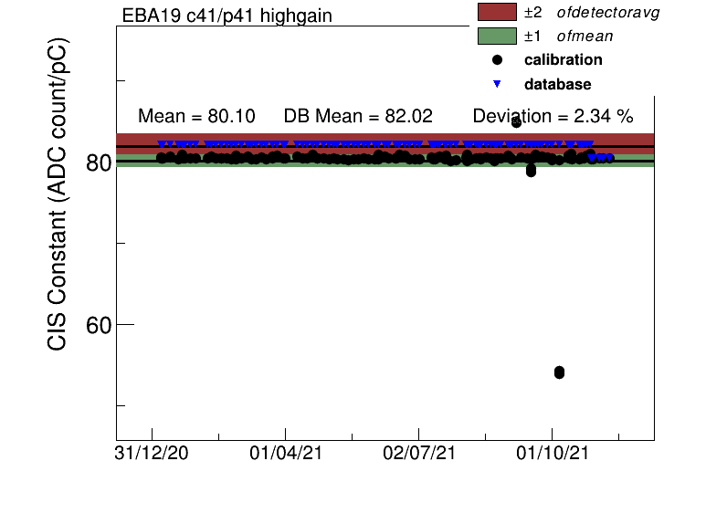
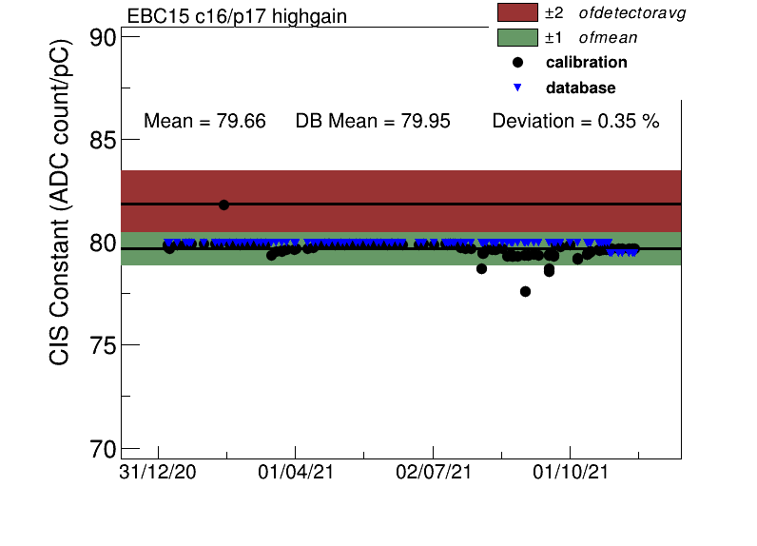

Slide 19
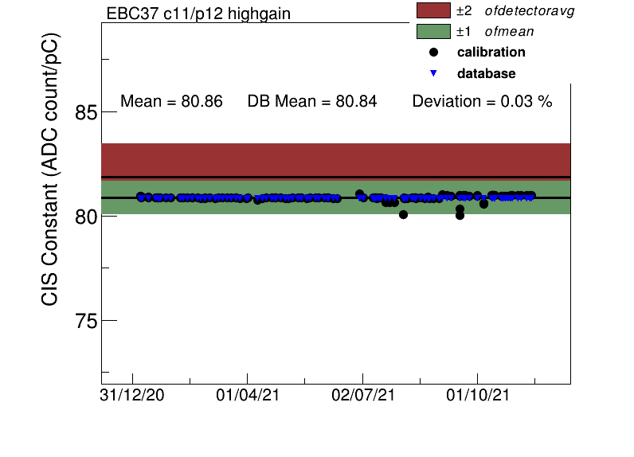
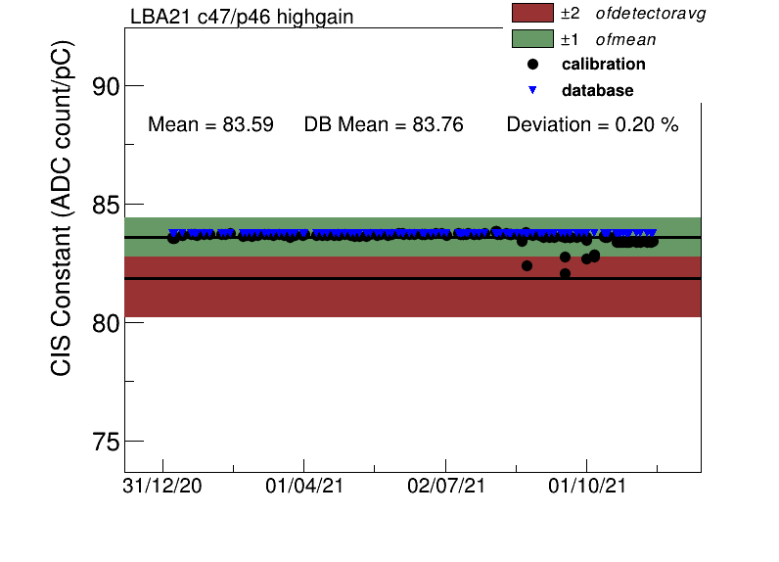
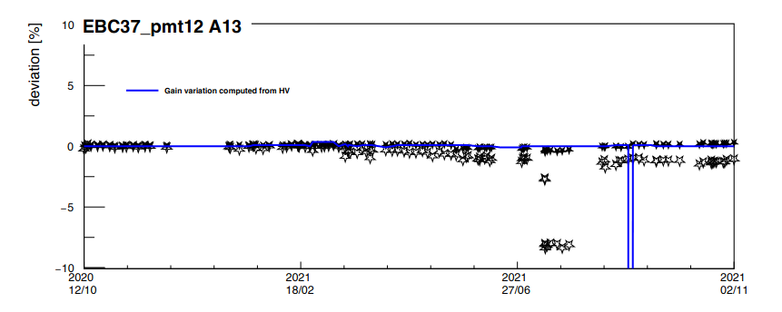
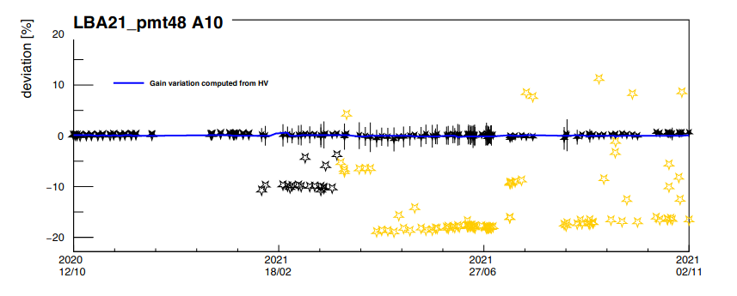

Slide 20
